Slide 1

Chapter 4 Loops

Slide 2
Objectives
To use while, do-while, and for loops to execute statements repeatedly (§§4.2-4.4).
To understand the flow of control in loops (§§4.2-4.4).
To use Boolean expressions to control loops (§§4.2-4.4).
To write nested loops (§4.5).
To know the similarities and differences of three types of loops (§4.6).
(Optional) To implement program control with break and continue (§4.7).
(Optional) To read and write data from/to a file (§4.11).

Slide 3
Loops Introduction
C++ provides a powerful control structure called a loop, which controls how many times an operation or a sequence of operations is performed in succession. Using a loop statement, you simply tell the computer to print a string a hundred times without having to code that print statement a hundred times.
Loops are structures that control repeated executions of a block of statements. The concept of looping is fundamental for programming languages. C++ provides three types of loop statements: while loop, do-while loops and for loops.

Slide 4
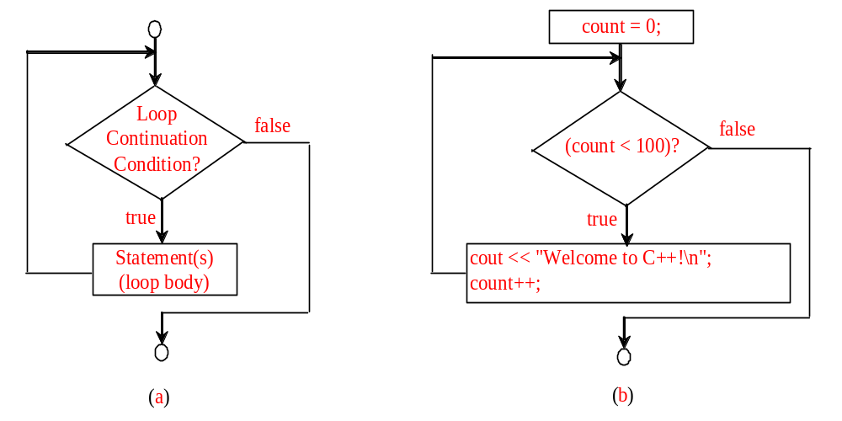
while Loop Flow Chart
The repeated part is called loop body, which consists of several statements. Each loop contains a loop-continuation-condition, a Boolean expression that controls the execution of the body. It is always evaluated before the loop body is executed.
The variable count is initially 0. The loop checks whether count<100 is true. If so, it executes the loop body to print the message “Welcome to C++!” and increment count by 1. It repeatedly executes the loop body until count<100 is false. If the evaluation is false, the loop terminates and the next statement after the loop is executed.
while (loop-continuation-condition)
{
// loop-body;
Statement(s);
}
int count = 0;
while (count < 100)
{
cout << "Welcome to C++!\n";
count++;
}

Slide 5
Trace while Loop
animation
Initialize count
int count = 0;
while (count < 2)
{
cout << "Welcome to C++!";
count++;
}

Slide 6
Trace while Loop, cont.
animation
(count < 2) is true
int count = 0;
while (count < 2)
{
cout << "Welcome to C++!";
count++;
}

Slide 7
Trace while Loop, cont.
animation
Print Welcome to C++
int count = 0;
while (count < 2)
{
cout << "Welcome to C++!";
count++;
}

Slide 8
Trace while Loop, cont.
animation
Increase count by 1
count is 1 now
int count = 0;
while (count < 2)
{
cout << "Welcome to C++!";
count++;
}

Slide 9
Trace while Loop, cont.
animation
(count < 2) is still true since count is 1
int count = 0;
while (count < 2)
{
cout << "Welcome to C++!";
count++;
}

Slide 10
Trace while Loop, cont.
animation
Print Welcome to C++
int count = 0;
while (count < 2)
{
cout << "Welcome to C++!";
count++;
}

Slide 11
Trace while Loop, cont.
animation
Increase count by 1
count is 2 now
int count = 0;
while (count < 2)
{
cout << "Welcome to C++!";
count++;
}

Slide 12
Trace while Loop, cont.
animation
(count < 2) is false since count is 2 now
int count = 0;
while (count < 2)
{
cout << "Welcome to C++!";
count++;
}

Slide 13
Trace while Loop
animation
The loop exits. Execute the next statement after the loop.
int count = 0;
while (count < 2)
{
cout << "Welcome to C++!";
count++;
}

Slide 14
Example: An Advanced Math Learning Tool
The Math subtraction tutor program in Listing 3.6, SubtractionTutor.cpp, generates just one question for each run. You can use a loop to generate questions repeatedly. Listing 4.1 gives a program that generates ten questions and reports the number of the correct answers after a student answers all ten questions. The program also displays the time spent on the test and lists all the questions, as shown in sample output.
SubtractionTutorLoop

Slide 15
Controlling a Loop with User Confirmation
The preceding example executes the loop ten times. Suppose you want the user to decide whether to take another question, you can let the uses control the loop with a user confirmation.
char continueLoop = 'Y';
while (continueLoop == 'Y')
{
// Execute body once
// Prompt the user for confirmation
cout << "Enter Y to continue and N to quit: ";
cin >> continueLoop;
}

Slide 16
Ending a Loop with a Sentinel Value
Often the number of times a loop is executed is not predetermined. You may use an input value to signify the end of the loop. Such a value is known as a sentinel value.
Write a program that reads and calculates the sum of an unspecified number of integers. The input 0 signifies the end of the input.
SentinelValue
Notes:
sentinel 哨兵

Slide 17
Caution
Don’t use floating-point values for equality checking in a loop control. Since floating-point values are approximations, using them could result in imprecise counter values and inaccurate results. This example uses int value for data. If a floating-point type value is used for data, (data == 0) may be false even though data is 0.
  double data = pow(sqrt(2.0), 2) - 2;
  if (data == 0)
  cout << "data is zero";
  else
  cout << "data is not zero";
Notes:
Sqrt is a function in the cmath header file for computing the square root of a number.

Slide 18
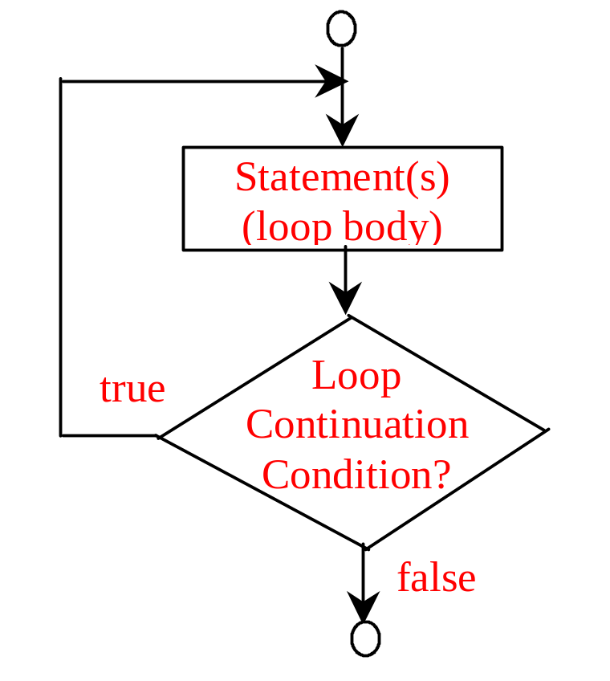
do-while Loop
The do-while loop is a variation of the while loop. It’s syntax is given below.
do
{
// Loop body;
Statement(s);
} while (loop-continuation-condition);
Notes:
The loop body is evaluated first. Then the loop-continuation-condition is evaluated. If the evaluation is true, the loop body is executed again. If false, the do-while loop terminates.

Slide 19
do-while Loop
If you have statements in side the loop that must be executed at least once, use the do-while loop.
Notes:
The loop body is evaluated first. Then the loop-continuation-condition is evaluated. If the evaluation is true, the loop body is executed again. If false, the do-while loop terminates.

Slide 20
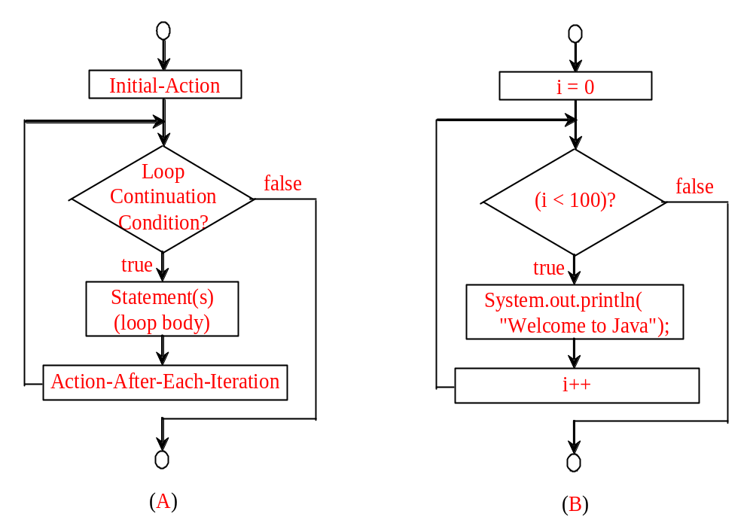
for Loops
for (initial-action; loop-continuation-condition; action-after-each-iteration)
{
// loop body;
Statement(s);
}
int i;
for (i = 0; i < 100; i++)
{
cout << "Welcome to C++!\n";
}
The for loop statement starts with the keyword for, followed by a pair of parentheses enclosing initial-action, loop-continuation-condition, and action-after-each-iteration, and followed by the loop the body enclosed inside braces.
Notes:
Initial-action, loop-continuation-condition and action-after-each-iteration are separated by semicolons.
Initial-action often initiates a control variable. Action-after-each-iteration usually increments or decrements the control variable. The loop-continuation-condition often tests whether the control variable has reached a termination value.

Slide 21
Trace for Loop
animation
Declare i
int i;
for (i = 0; i < 2; i++)
{
cout << "Welcome to C++!";
}

Slide 22
Trace for Loop, cont.
animation
Execute initializer
i is now 0
int i;
for (i = 0; i < 2; i++)
{
cout << "Welcome to C++!";
}

Slide 23
Trace for Loop, cont.
animation
(i < 2) is true
since i is 0
int i;
for (i = 0; i < 2; i++)
{
cout << "Welcome to C++!";
}

Slide 24
Trace for Loop, cont.
animation
Print Welcome to C++!
int i;
for (i = 0; i < 2; i++)
{
cout << "Welcome to C++!";
}

Slide 25
Trace for Loop, cont.
animation
Execute adjustment statement
i now is 1
int i;
for (i = 0; i < 2; i++)
{
cout << "Welcome to C++!";
}

Slide 26
Trace for Loop, cont.
animation
(i < 2) is still true
since i is 1
int i;
for (i = 0; i < 2; i++)
{
cout << "Welcome to C++!";
}

Slide 27
Trace for Loop, cont.
animation
Print Welcome to C++
int i;
for (i = 0; i < 2; i++)
{
cout << "Welcome to C++!";
}

Slide 28
Trace for Loop, cont.
animation
Execute adjustment statement
i now is 2
int i;
for (i = 0; i < 2; i++)
{
cout << "Welcome to C++!";
}

Slide 29
Trace for Loop, cont.
animation
(i < 2) is false
since i is 2
int i;
for (i = 0; i < 2; i++)
{
cout << "Welcome to C++!";
}

Slide 30
Trace for Loop, cont.
animation
Exit the loop. Execute the next statement after the loop
int i;
for (i = 0; i < 2; i++)
{
cout << "Welcome to C++!";
}

Slide 31
Note
The initial-action in a for loop can be a list of zero or more comma-separated expressions. The action-after-each-iteration in a for loop can be a list of zero or more comma-separated statements. Therefore, the following two for loops are correct. They are rarely used in practice, however.
  for (int i = 1; i < 100; cout << (i++));
  for (int i = 0, j = 0; (i + j < 10); i++, j++) {
  // Do something
  }

Slide 32
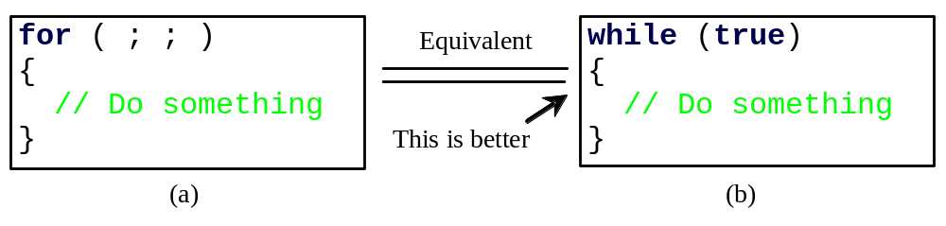
Note
If the loop-continuation-condition in a for loop is omitted, it is implicitly true. Thus the statement given below in (a), which is an infinite loop, is correct. Nevertheless, it is better to use the equivalent loop in (b) to avoid confusion:

Slide 33
Example: Using for Loops
Problem: Write a program that sums a series that starts with 0.01 and ends with 1.0. The numbers in the series will increment by 0.01, as follows: 0.01 + 0.02 + 0.03 and so on.
TestSum

Slide 34


Which Loop to Use?
The three forms of loop statements, while, do-while, and for, are expressively equivalent; that is, you can write a loop in any of these three forms. For example, a while loop in (a) in the following figure can always be converted into the following for loop in (b):
A for loop in (a) in the following figure can generally be converted into the following while loop in (b) except in certain special cases (see Review Question 3.19 for one of them):

Slide 35
Recommendations
Use the one that is most intuitive and comfortable for you. In general, a for loop may be used if the number of repetitions is known, as, for example, when you need to print a message 100 times. A while loop may be used if the number of repetitions is not known, as in the case of reading the numbers until the input is 0. A do-while loop can be used to replace a while loop if the loop body has to be executed before testing the continuation condition.

Slide 36
Nested Loops
Nested loops consists of an outer loop and one or more inner loops. Each time the outer loop is repeated, the inner loops are reentered and started anew.
Problem: Write a program that uses nested for loops to print a multiplication table.
MultiplicationTable

Slide 37
Example:
Finding the Greatest Common Divisor
Problem: Write a program that prompts the user to enter two positive integers and finds their greatest common divisor.
Solution: Suppose you enter two integers 4 and 2, their greatest common divisor is 2. Suppose you enter two integers 16 and 24, their greatest common divisor is 8. So, how do you find the greatest common divisor? Let the two input integers be n1 and n2. You know number 1 is a common divisor, but it may not be the greatest commons divisor. So you can check whether k (for k = 2, 3, 4, and so on) is a common divisor for n1 and n2, until k is greater than n1 or n2.
GreatestCommonDivisor

Slide 38
Example: Finding the Sales Amount
Problem: You have just started a sales job in a department store. Your pay consists of a base salary and a commission. The base salary is $5,000. The scheme shown below is used to determine the commission rate.
      Sales Amount Commission Rate
      $0.01–$5,000 8 percent
      $5,000.01–$10,000 10 percent
      $10,000.01 and above 12 percent
Your goal is to earn $30,000 in a year. Write a program that will find out the minimum amount of sales you have to generate in order to make $30,000.
FindSalesAmount
Notes:
Commission rate 佣金
This example is for your self taught.

Slide 39
Example:
Displaying a Pyramid of Numbers
Problem: Write a program that prompts the user to enter an integer from 1 to 15 and displays a pyramid. For example, if the input integer is 7, the output is shown below.
1
2 1 2
3 2 1 2 3
4 3 2 1 2 3 4
5 4 3 2 1 2 3 4 5
6 5 4 3 2 1 2 3 4 5 6
7 6 5 4 3 2 1 2 3 4 5 6 7
PrintPyramid

Slide 40
Using break and continue
Examples for using the break and continue keywords:
break immediately ends the innermost loop that contains it. In other words, break breaks out of a loop.
TestBreak.cpp
Test Break
continue only ends the current iteration. Program control goes to the end of the loop body. In other words, continue breaks out of an iteration.
TestContinue.cpp
Test Continue

Slide 41
Example: Displaying Prime Numbers
Problem: Write a program that displays the first 50 prime numbers in five lines, each of which contains 10 numbers. An integer greater than 1 is prime if its only positive divisor is 1 or itself. For example, 2, 3, 5, and 7 are prime numbers, but 4, 6, 8, and 9 are not.
Solution: The problem can be broken into the following tasks:
  For number = 2, 3, 4, 5, 6, ..., test whether the number is prime.
  Determine whether a given number is prime.
  Count the prime numbers.
  Print each prime number, and print 10 numbers per line.
Prime Number

Slide 42
File Input and Output
You used the cin to read input from the keyboard and the cout to write output to the console. You can also read and write data from/to a file. This section introduces simple file input and output. Detailed coverage of file input and output will be presented in Chapter 12.
SimpleFileOutput
SimpleFileInput

Slide 43
Testing End of a File
Listing 4.13 reads three numbers from the data file. If you don’t know how many numbers are in the file and want to read them all, how do you know the end of file? You can invoke the eof() function on the input object to detect it. Listing 4.14 revises Listing 4.13 to read all lines from the file numbers.txt.
TestEndOfFile

Slide 44
Chapter Summary
Program control specifies the order in which statements are executed in a program. There are three types of control statements: sequence, selection and repetition. The preceding chapters introduced sequence and selection statements. This chapter introduced the repetition statements.

Slide 45
Chapter Summary
There are three types of repetition statements: the while loop, the do-while loop, and the for loop. In designing loops, you need to consider both the loop control structure and the loop body.

Slide 46
Chapter Summary
The while loop checks the loop-continuation-condition first. If the condition is true, the loop body is executed; if it is false, the loop terminates. The do-while loop is similar to the while loop, except that the do-while loop executes the loop body first and then checks the loop-continuation-condition to decide whether to continue or to terminate.

Slide 47
Chapter Summary
Since the while loop and the do-while loop contain the loop-continuation-condition, which is dependent on the loop body, the number of repetitions is determined by the loop body. The while loop and the do-while loop are often used when the number of repetitions is unspecified.

Slide 48
Chapter Summary
The for loop generally is used to execute a loop body a predictable number of times. This number is not determined by the loop body. The loop control has three parts. The first part is an initial action that often initializes a control variable. The second part, the loop-continuation-condition, determines whether the loop body is to be executed. The third part is executed after each iteration and is often used to adjust the control variable. Usually, the loop control variables are initialized and changed in the control structure.

Slide 49
Chapter Summary
Two keywords, break and continue, can be used in a loop. The break keyword immediately ends the innermost loop, which contains the break. The continue keyword only ends the current iteration.

